Slide 1
Machine Learning in Business John C. Hull
Chapter 6
Supervised Learning: Neural Networks

Slide 2
A Simple ANN (Artificial Neural Network), Figure 6.1

Slide 3
Activation Functions
H is not related directly to the features
There is a hidden layer with neurons
H is related to the V_{k}
The V_{k} are related to the features
Activation functions define the relationships

Slide 4
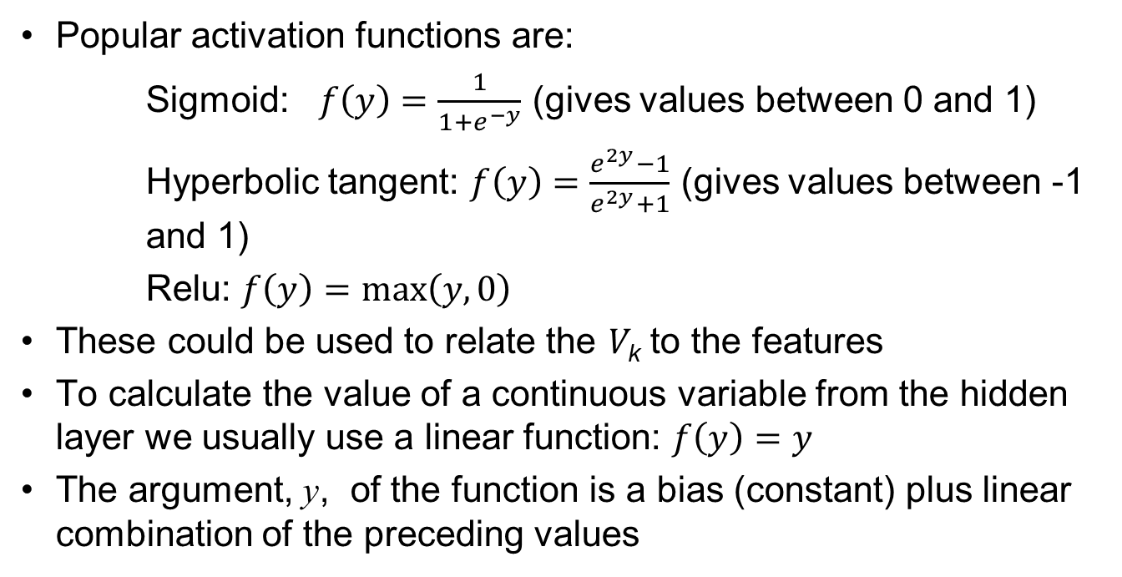
Activation Functions continued
Popular activation functions are:
Sigmoid: $f\left(y\right)=\frac{1}{1+e^{−y}}$ (gives values between 0 and 1)
Hyperbolic tangent: $f\left(y\right)=\frac{e^{2y}−1}{e^{2y}+1}$ (gives values between -1 and 1)
Relu: $f\left(y\right)=\max\left(y,0\right)$
These could be used to relate the V_{k} to the features
To calculate the value of a continuous variable from the hidden layer we usually use a linear function: $f\left(y\right)=y$
The argument, y, of the function is a bias (constant) plus linear combination of the preceding values

Slide 5
One possible set of equations for the house price example

Slide 6
Another Example (Figure 6.2)
This works in the same way as the previous example except that the sigmoid function would usually be used to relate Q to the V “s

Slide 7
Universal Approximation Theorem
Any continuous function can be approximated to arbitrary accuracy with one hidden layer (See K. Hornik: Neural Networks, 1991, 4:251-257)
But this may require a very large number of neurons.
Using several hidden layers can be computationally more efficient

Slide 8
A Generalization (Figure 6.3)

Slide 9
Number of Parameters
Neural networks can have a very large number of parameters
If there are F features, H hidden layers, M neurons in each hidden layer and T targets the number of parameters is
(F+1)M+M(M+1)(H-1)+(M+1)T
The first (house price) neural network has 13 parameters and the second (credit) neural network has 19 parameters
But in practice a small neural network might have 4 features, 3 hidden layers, 80 neurons per layer and one target for a total of 13,441 parameters.
Larger neural networks have hundreds of thousands of parameters

Slide 10
Gradient Descent and Neural Nets
To minimize an objective function such as mse, a gradient descent algorithm calculates the direction of steepest descent, takes a step, calculate a new direction of steepest descent, takes another step, and so on
The partial derivatives with respect to the parameters are calculated by a procedure known as backpropagation. We work back through the network using the chain rule. (See Runnelhart, Hinton, and Williams, Nature, 1986, 323, 533-536)
The size of the step is the learning rate. If the step is too small the algorithm will be very slow. If it is too large there are liable to be oscillations

Slide 11
Simple Example: Calculating a single regression coefficient, b (Figure 6.4)

Slide 12
When Learning Rate is 0.0002 (Table 6.2)
Iteration | Value of b | Gradient | Change in b
0 | 1.0000 | −15,986.20 | +3.1972
1 | 4.1972 | −2,906.93 | +0.5814
2 | 4.7786 | −528.60 | +0.1057
3 | 4.8843 | −96.12 | +0.0192
4 | 4.9036 | −17.48 | +0.0035
5 | 4.9071 | −3.18 | +0.0006
6 | 4.9077 | −0.58 | +0.0001
7 | 4.9078 | −0.11 | +0.0000
8 | 4.9078 | −0.02 | +0.0000
9 | 4.9078 | 0.00 | +0.0000

Slide 13
When Learning Rate is 0.00001 (Table 6.3)
Iteration | Value of b | Gradient | Change in b
0 | 1.0000 | −15,986.20 | +0.1599
1 | 1.1599 | −15,332.24 | +0.1533
2 | 1.3132 | −14,705.03 | +0.1471
3 | 1.4602 | −14,104.47 | +0.1410
4 | 1.6013 | −13,526.53 | +0.1353
5 | 1.7365 | −12,973.18 | +0.1297
6 | 1.8663 | −12,442.48 | +0.1244
7 | 1.9907 | −11,933.48 | +0.1193
8 | 2.1100 | −11,445.31 | +0.1145
9 | 2.2245 | − 10,977.37 | +0.1098

Slide 14
When Learning Rate is 0.0005 (Table 6.4)
Iteration | Value of b | Gradient | Change in b
0 | 1.0000 | −15,986.20 | +7.9931
1 | 8.9931 | 16,711.97 | −8.3560
2 | 0.6371 | −17,470.70 | +8.7353
3 | 9.3725 | 18,263.87 | −9.1319
4 | 0.2405 | −19,093.05 | +9.5465
5 | 9.7871 | 19,959.87 | −9.9799
6 | −0.1929 | −20,866.05 | +10.4330
7 | 10.2401 | 21,813.37 | −10.9067
8 | 0.6665 | −22,803.69 | +11.4018
9 | 10.7353 | 23,838.98 | −11.9195

Slide 15
Other Details
Use mini batches of data to calculate gradients. (One epoch is one complete use of training set.)
Use a momentum strategy
Adaptively calculate the learning rate (Adam)
Learning rate decay
Dropouts

Slide 16
Local Minima
Important to try and avoid local minima
A
B
C
Parameter Value

Slide 17
Stopping Rule
Because applications have many parameters it is important to use a stopping rule to avoid over-fitting
We calculate results for the validation set at the same time as the training set.
When the results for the validation set start to get worse we stop

Slide 18
Black-Scholes-Merton Application
We generated 10,000 call option prices using the Black-Scholes-Merton model and then added a normally distributed error of 0.15 to the price.
The parameters were sampled randomly from uniform distributions
The model had three hidden layers and 20 neurons per layer

Slide 19
Training set and validation set mse as the epochs of training is increased

Slide 20
Smoothed mse (Moving Average over 50 epochs)

Slide 21
Results
With only 10,000 observations the neural network imitated the Black-Scholes-Merton model well
It eliminated much of the random noise we added to the BSM prices.

Slide 22
Application to Derivatives
Some instruments are valued using Monte Carlo simulation
But banks often have to use Monte Carlo simulation for scenario analysis and to calculate the VAs
There is then a “Monte Carlo within Monte Carlo” problem.
To solve the problem you can do an initial analysis to generate a large amount of data relating prices to input variables
Use a neural network to get a good fast approximation for a pricing model

Slide 23
Autoencoders
In an autoencoder the input and output are the same
The objective is similar to PCA: to find a small number of features that capture nearly all the properties of the data

Slide 24
Using an autoencoder for interest rates

Slide 25
Results
An autoencoder with linear activation functions produces an equivalent result to PCA
The PCA factors are uncorrelated and easier to use
But autoencoders can use non-linear activation functions
They have been found to be useful in language translation and image recognition

Slide 26
Convolutional Neural Network (CNN)
In a vanilla ANN the layers are fully connected which can give rise to a very large number of parameters
In a convolutional neural network, the number of neurons in one layer that affect the next layer is reduced.
Used for image recognition where each pixel can be a feature
Consistent with the way neurons in the eye work

Slide 27
A “receptive field” in input layer determines value at a neuron in “feature map” of first hidden layer

Slide 28
CNN: More Details
There are several layers as in a regular neural network
Each layer is actually three-dimensional consisting of several two-dimensional feature maps
For each feature map, biases and weights are the same across all receptive fields
There may be “padding” where extra observations are added at the edges to avoid successive layers becoming smaller

Slide 29
CNN: Key Advantages
Consider a image that is 100×100 or 10,000 pixels
A regular neural network would lead to 10,000×(10,000+1) or about 100 million parameters to define the first layer.
If a CNN’s receptive field is 10×10 and a layer has 6 feature maps only 6×101=606 are required
More importantly, once the CNN has learned to recognize a pattern in one location it can recognize it in another location.

Slide 30
Recurrent Neural Network (RNN)
In a vanilla ANN, the v’s are functions of the inputs and the sequence of the inputs does not matter
In a recurrent neural network there is a time dimension to the data. The current v’s are made functions of the corresponding previous v’s (or possibly previous outputs) as well as current inputs
A long short-term memory (LSTM) network is a type of RNN where part of the algorithm learns what should be remembered and what should be forgotten from previous data

Slide 31
RNN: Applications
Sequential data where the relationship between targets and features may be changing through time
Particularly relevant for finance where we are often dealing with time series data
Also use in natural language processing (e.g. autocomplete tool)

